Slide 1
Deterministic Finite Automaton
By Samuel Adeniyi

Slide 2
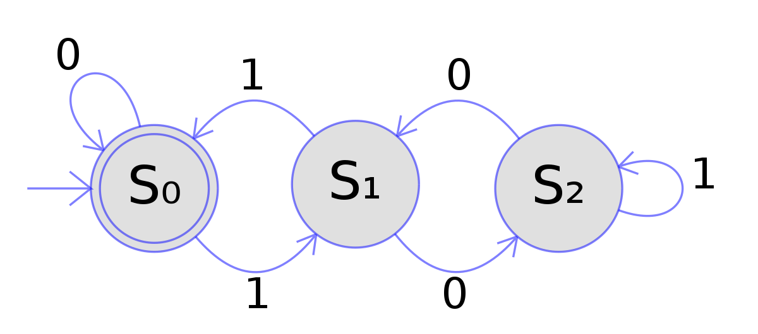
What is an Deterministic Finite Automaton
First, we need to define finite Automaton. A Finite Automaton is a simple theoretical model that is used to recognize patterns and determine when an input is entered to accept it or reject it based on the pattern.
A Deterministic Finite Automaton has a fixed state and machine knows the next state of the next input.
Real life examples of Deterministic Finite Automaton include; elevators, vending machines, and traffic-sensitive traffic lights

Slide 3
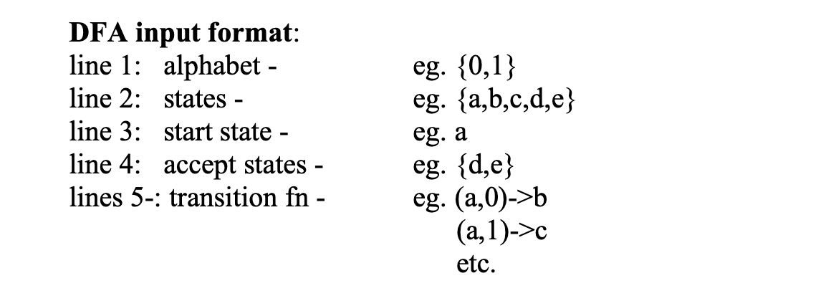
DFA Project
In this project, a java program was created to simulate the process of a DFA machine when given a text file. The alphabet, states, start states, accept state, and transition
After reading the file given by the user and displaying it the console, It asks the user to input a string. Using a method, it determines if the accepted or rejected by the set of rules
Using the transition rules given in the file, it processes the string to see if it matches the accept state.

Slide 4
MyDfaSample.txt File State Diagram
0
1
Alphabet: {0,1}
States: {a,b,c}
Start state: a
Accept States: {b}
Transition rules are:
(a,0)->a
(a,1)->c
(b,0)->a
(b,1)->c
(c,0)->b
(c,1)->c
A
1
C
0
1
0
B

Slide 5
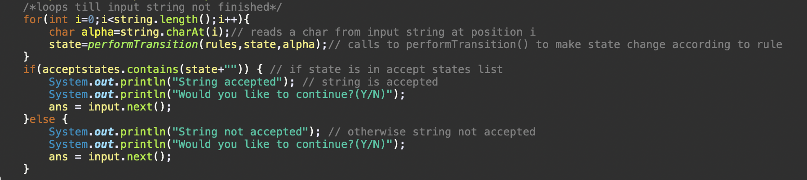
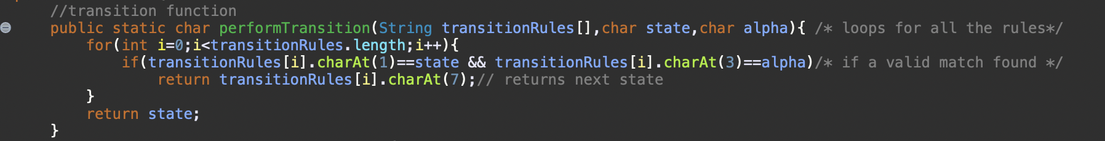
Java Project Code
After opening and reading the text file, the program ask the user to input a string with the given alphabet given to them by the file, in this case {0,1}. Taking the string imputed by the user, it is place into a loop where the method performTransition is called for each character in the string.
The performTransition method uses the given transition rules and checks if the character is in the accept state. State being the current element, alpha being the previous element, and using the transition rule to determine if it fits the accept state

Slide 6
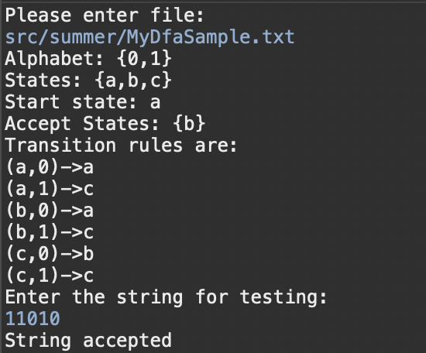
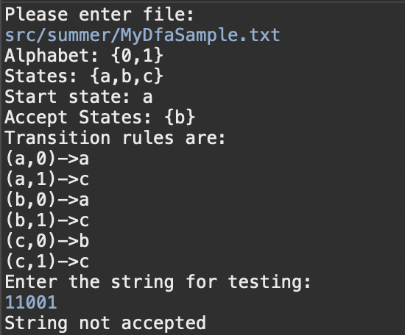
MyDfaSample.txt File
String accepted
String rejected
This is mine DFA input for the program. It accepts any string that ends with ‘10’.
{a} is the initial state of the DFA, waiting state for 1 to start the ‘10’ pattern.
{b} is the accepting stage, for the ‘10’
{c} acts the transition to determine if the string ends ‘10’ or loops on itself.
Regular expression: (0|1)*10
String 11010: Goes from A to C, loops back to C, C goes to B, B to C, and finally back to B to be accepted.
String 11001: Goes from A to C, loops back to C, goes to B, goes to A, and ends A leading to it to be rejected.

